Slide 1
Online turf booking system
By
Sivinash N
Vinolan Martin D
Sanjay kanna K

Slide 2
INTRODUCTION
The Turf Booking System is an easy to use for booking sports fields . IT helps players,
Teams, and events organizers reserve turf, manage schedule, and make payments .
With features like real time availability and secure transactions, it makes booking
sports facilities simple and convenient for everyone

Slide 3
ABSTRACT
The Turf booking System is a digital platform that simplifies booking sports fields
for users and helps turf owners manage their facilities . it offers real time availability,
secure payments, and automated notifications through user friendly web and mobile
apps. With strong security and scalability, it enhances turf usage and improves the
customer experience by automated the booking process.

Slide 4
MODULES
USER MANAGEMENT MODULE
Functionality
User registration and login (email, phone, or social media).
Role – based access control (user, admin / manager).
Profile management (update personal details, change password).
Features
Authentication (OAuth, JWT)
Forgot password and account recovery

Slide 5
Turf Management Module
FUNCTIONALITY
- Add , update, and delete turf details (name , location , size ,price , photos ).
categorize turfs by sport type (football , cricket , tennis ,etc.).
Set availability schedules and pricing.
FEATURES
- Turf Search and filtering (by location, sport, price, availability).
- Turf details page with reviews and ratings

Slide 6
Payment Module
Functionality
secure payment processing for bookings,
management fop cancellations,
Features
Integration with payment gateways (stripe, Razorpay, PayPal),
- Multiple payment options (credit/debit cards, UPI, wallets),
- payment history and invoices,

Slide 7
Manager Dashboard Module
Functionality
Add turf and managing turfs.
Monitoring bookings, payments, and revenue.
Generate reports and analytics.
Features
Centralized control panel.
Exportable reports (bookings, revenue, user activity).

Slide 8
REQUIREMENTS
SOFTWARE
Html
CSS
JavaScript
My SQL
Python(Flask)
HARDWARE
2.5GHz dual-processor
500 storage
Server with 4 GB RAM
Reliable internet connectivity

Slide 9
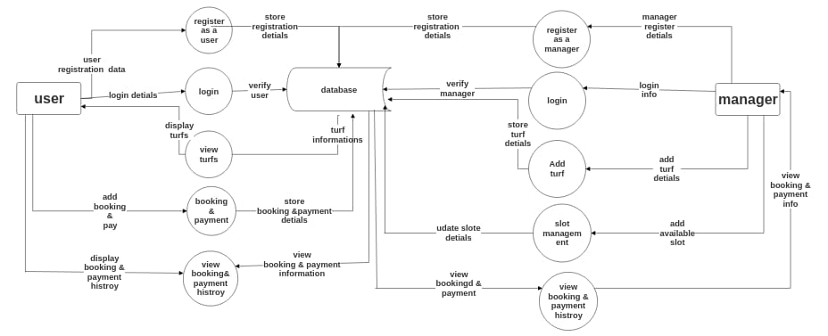
Data flow diagram

Slide 10
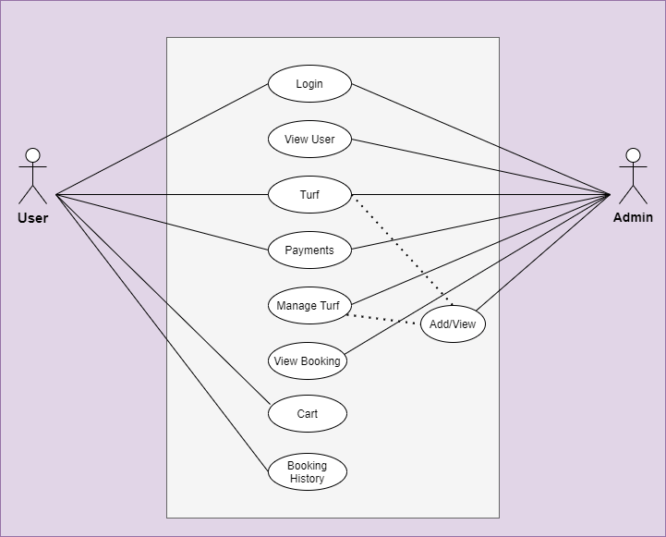
UML DIAGRAM

Slide 11
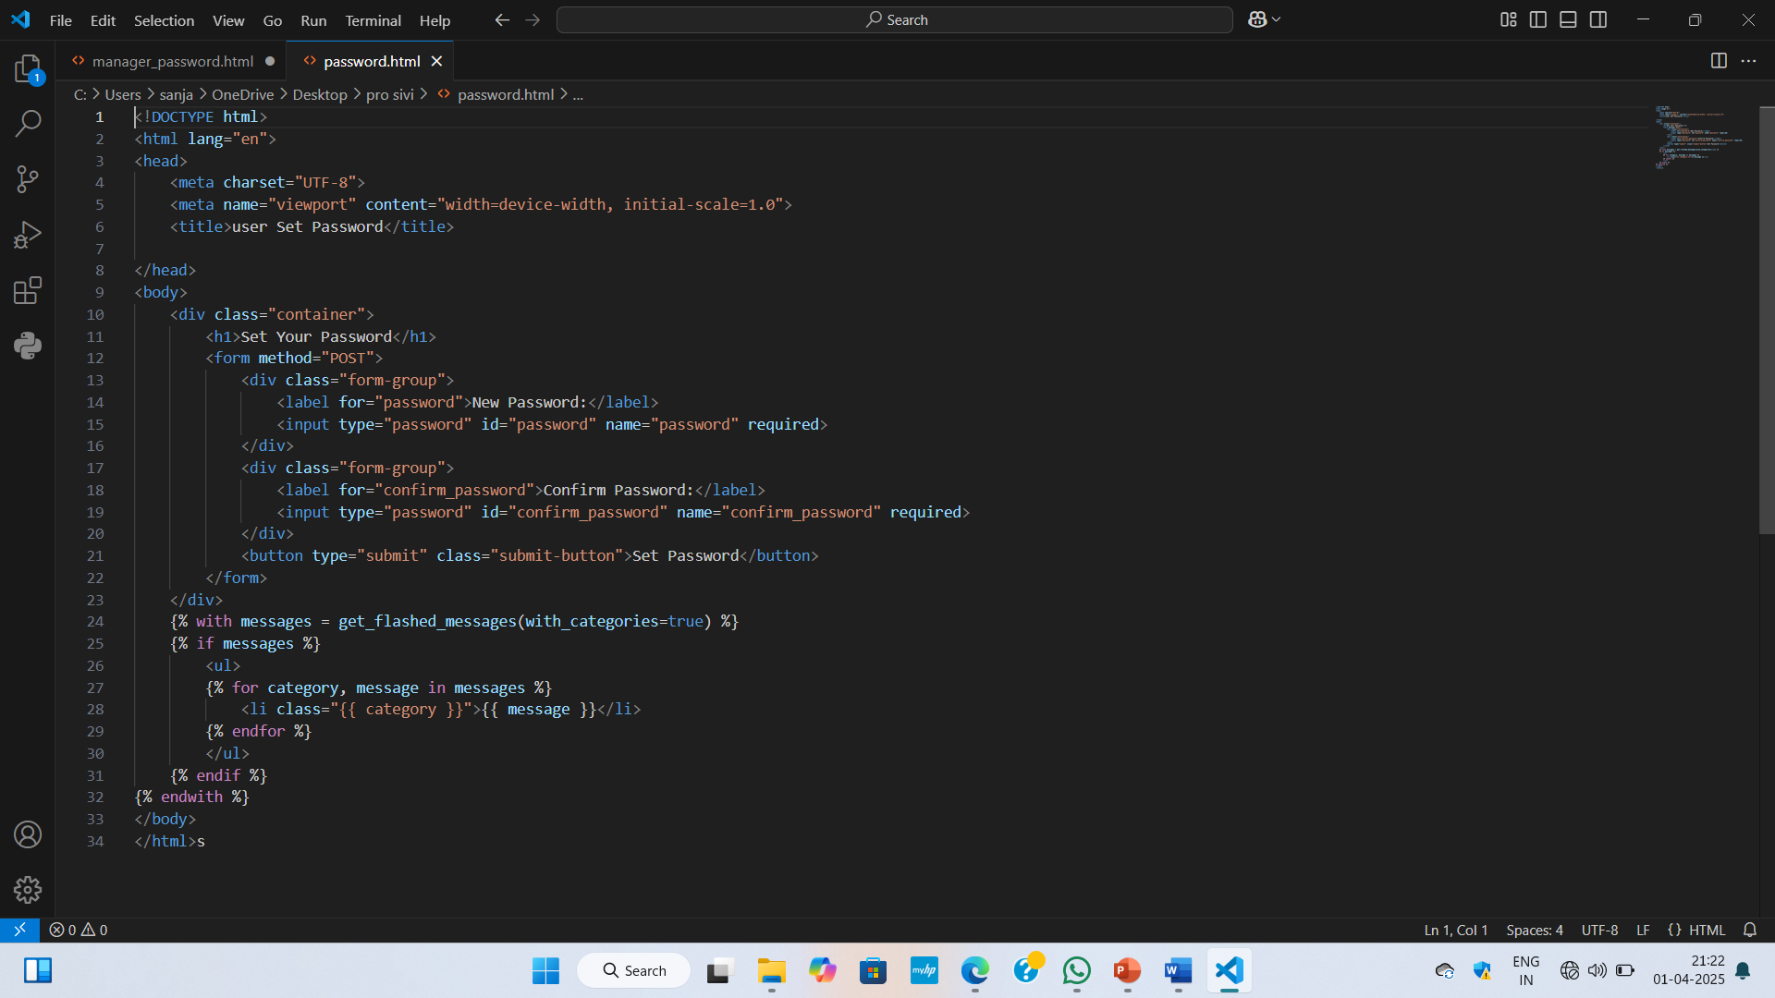
CODE

Slide 12
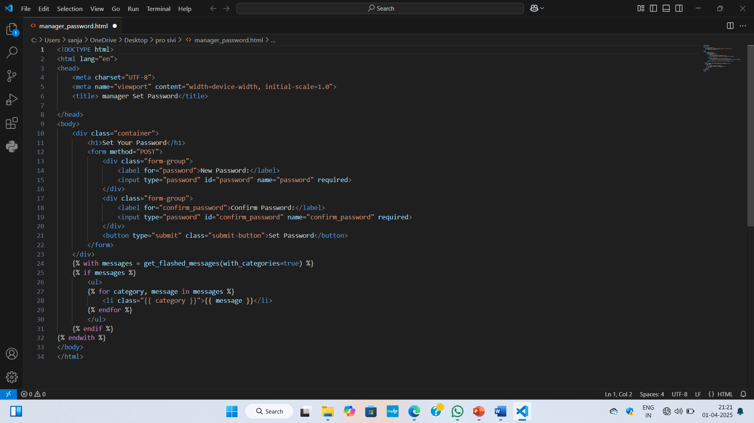

Slide 13
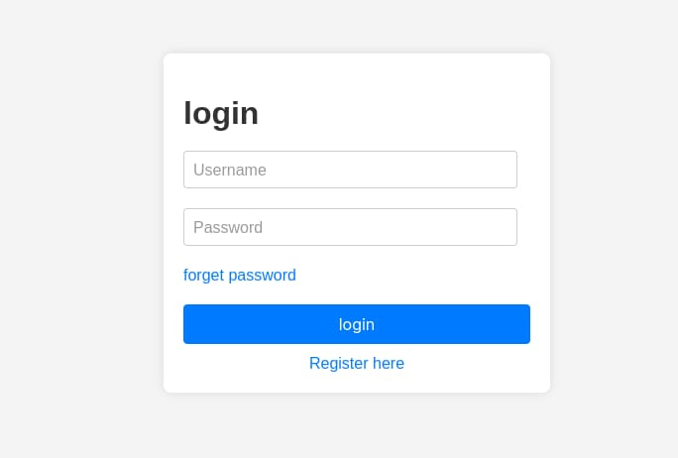
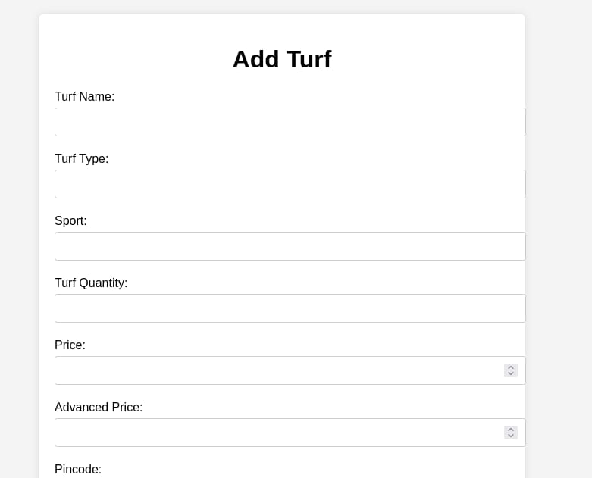
OUTPUT

Slide 14
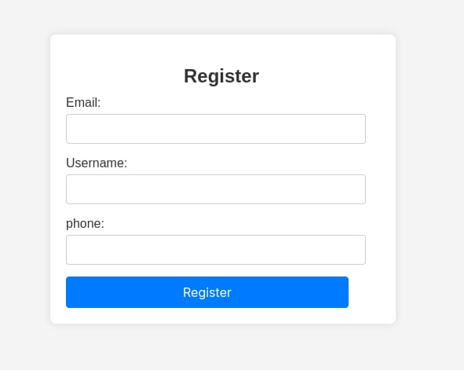
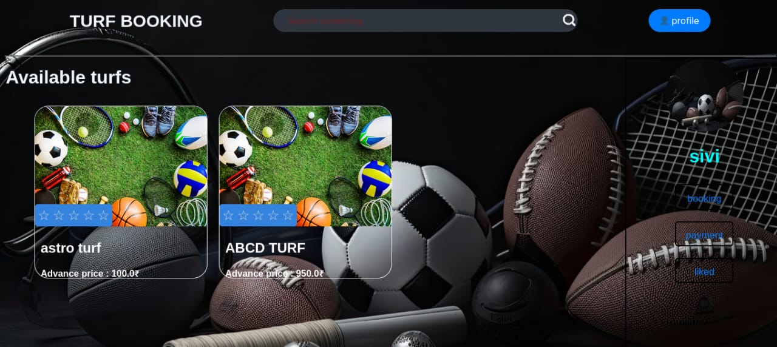
OUTPUT

Slide 15
CONCLUSION
Online Sports Turf Playground Booking System this project Sends message reminders to managers and users whenever slots are booked, canceled or rescheduled.
And your users can easily and securely authenticate themselves by linking their existing service by using a password.

Slide 16
Thank you

